Slide 1

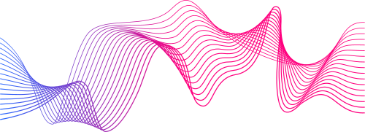
PROJECT 1 FACE RECOGNITION
PRESENTED BY
Indonesia AI - Computer Vision
CV B - Oppenheimer

Slide 2
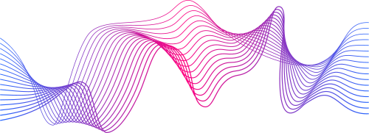
Man & Female Classification
Kebutuhan Identifikasi Gender
Latar Belakang
Identifikasi jenis kelamin merupakan aspek penting dalam banyak aplikasi, seperti keamanan, analisis demografi, dan pengalaman pengguna. Face recognition menjadi solusi utama untuk mengenali jenis kelamin seseorang secara otomatis
Meningkatnya Permintaan dari Industri Kecantikan
Industri kecantikan juga dapat memanfaatkan teknologi ini untuk memberikan rekomendasi produk yang lebih sesuai berdasarkan jenis kelamin pelanggan, meningkatkan pengalaman belanja

Slide 3
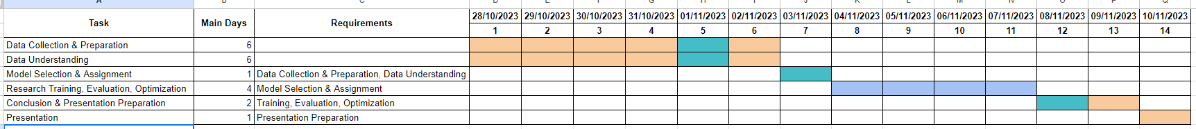
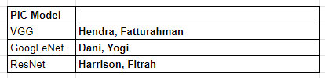
Timeline

Slide 4
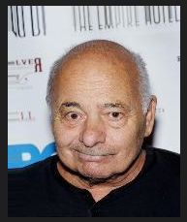
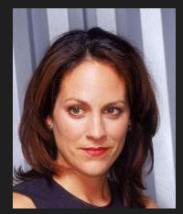
Dataset
CelebA
5000 face images
2953 Female
2047 Male
list_attribute.txt
`Male` column as target
Binary Classification

Slide 5
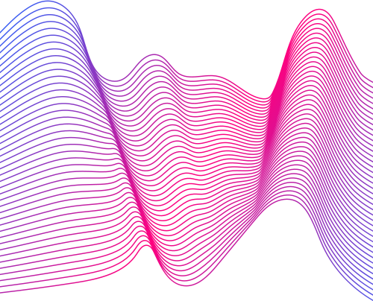
Model
VGG
GoogLeNet
ResNet

Slide 6
VGG
Preprocessing
Arsitektur Model
Hyperparameter
Evaluasi

Slide 7
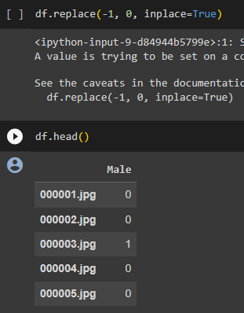
Preprocessing
Change the Feature Value -1 to 0

Slide 8
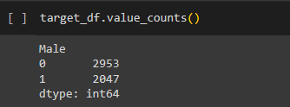
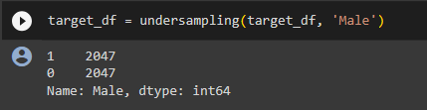
Preprocessing
Handle Imbalanced Data with Undersampling

Slide 9
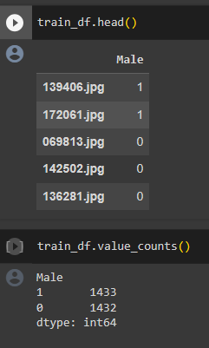
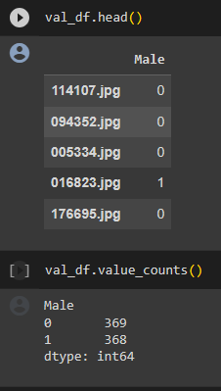
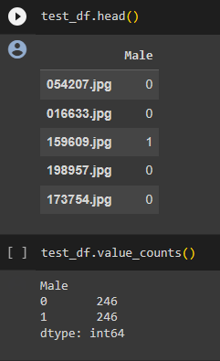
Preprocessing
Split the Dataset Into Train Val Test Split

Slide 10
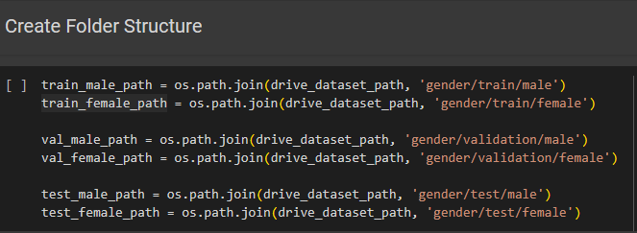
Preprocessing
Create Folder Structure

Slide 11
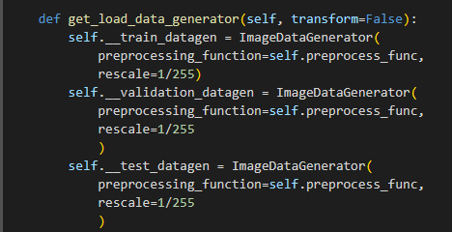
Preprocessing
create three image data generator objects and normalize the image with rescale = 1/255 for data augmentation and image preprocessing

Slide 12
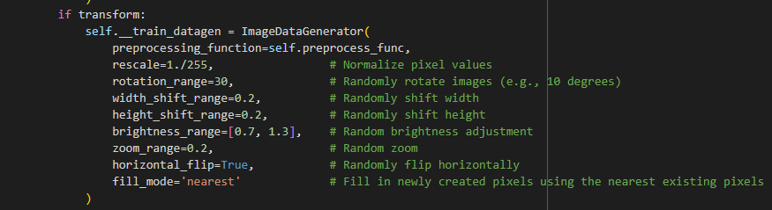
Preprocessing
Transform Data Train Images

Slide 13
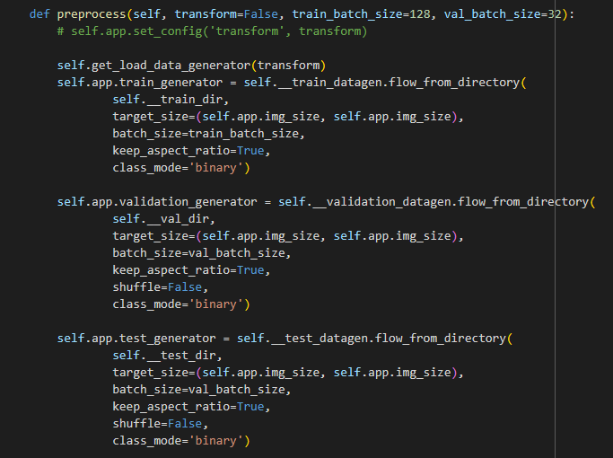
Preprocessing
Configure data generators for training, validation, and testing

Slide 14
Arsitektur Model
Input
224 x 224 x 3
Feature Extractor
VGG16 & VGG19 with pretrained weights imagenet
Fully Connected Layers
Flatten & 1 Dense layer 512 neurons activation relu
Output
Dense 1 neuron activation sigmoid
Binary cross entropy loss

Slide 15
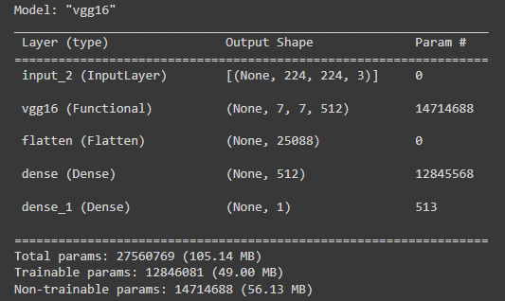
VGG16

Slide 16
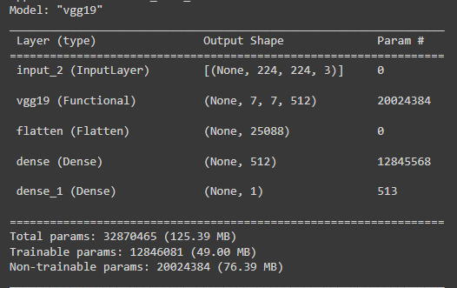
VGG19

Slide 17
Hyperparameter Optimization
Bayes
Transform (True / False)
Generator batch size (8, 16, 24, 32, 64)
Model batch size (8, 16, 24, 32, 64)
Optimizer
Adam
RMSprop
Optimizer learning rate
0.001
0.0001

Slide 18
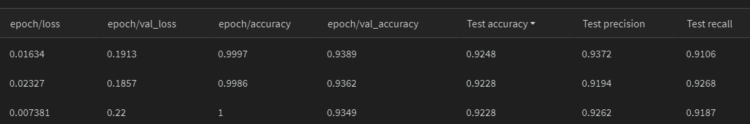
Hyperparameter Optimization
VGG16
Transform = False
Optimizer = Adam
learning rate = 0.001
Generator training batch size = 64
Generator validation batch size = 32
Model Training batch size = 64
Model Validation batch size = 32

Slide 19
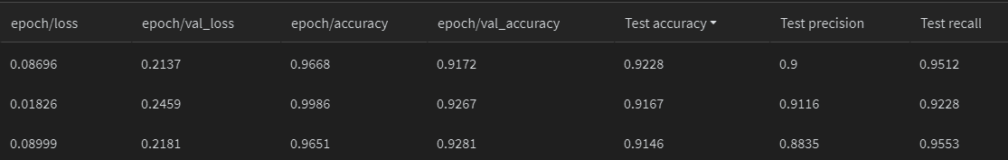
Hyperparameter Optimization
VGG19
Transform = False
Optimizer = RMSprop
learning rate = 0.0001
Generator training batch size = 24
Generator validation batch size = 8
Model Training batch size = 64
Model Validation batch size = 16

Slide 20
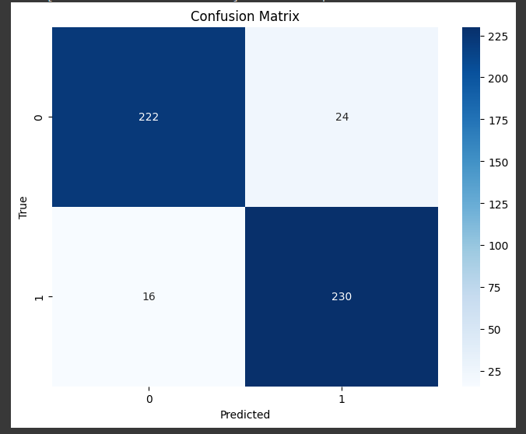
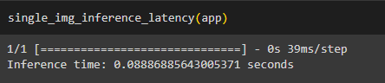
Evaluasi
VGG16
492 test data

Slide 21
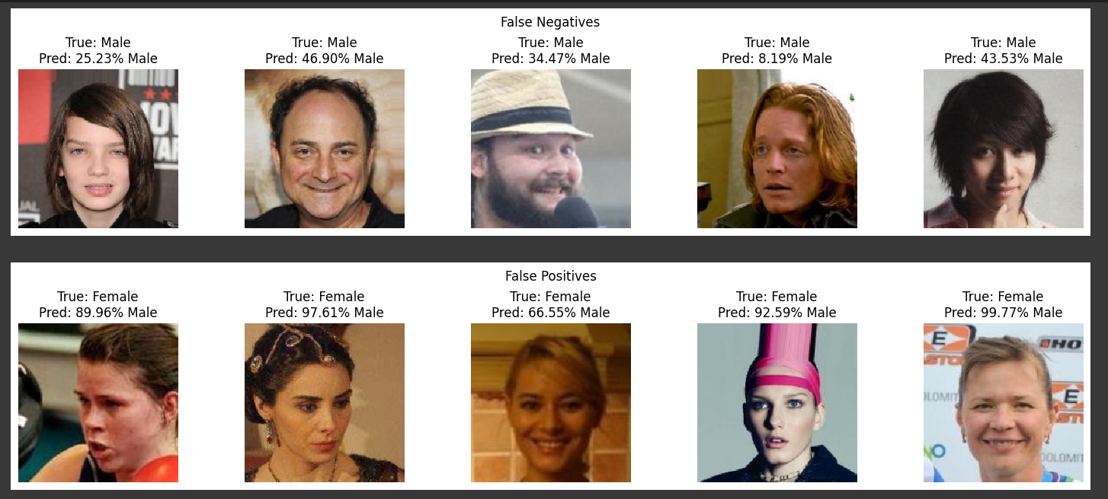
Evaluasi
VGG16

Slide 22
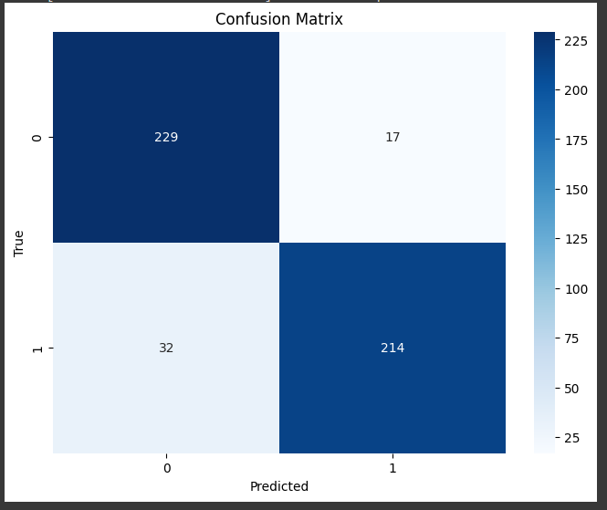
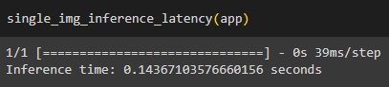
Evaluasi
VGG19
492 test data

Slide 23
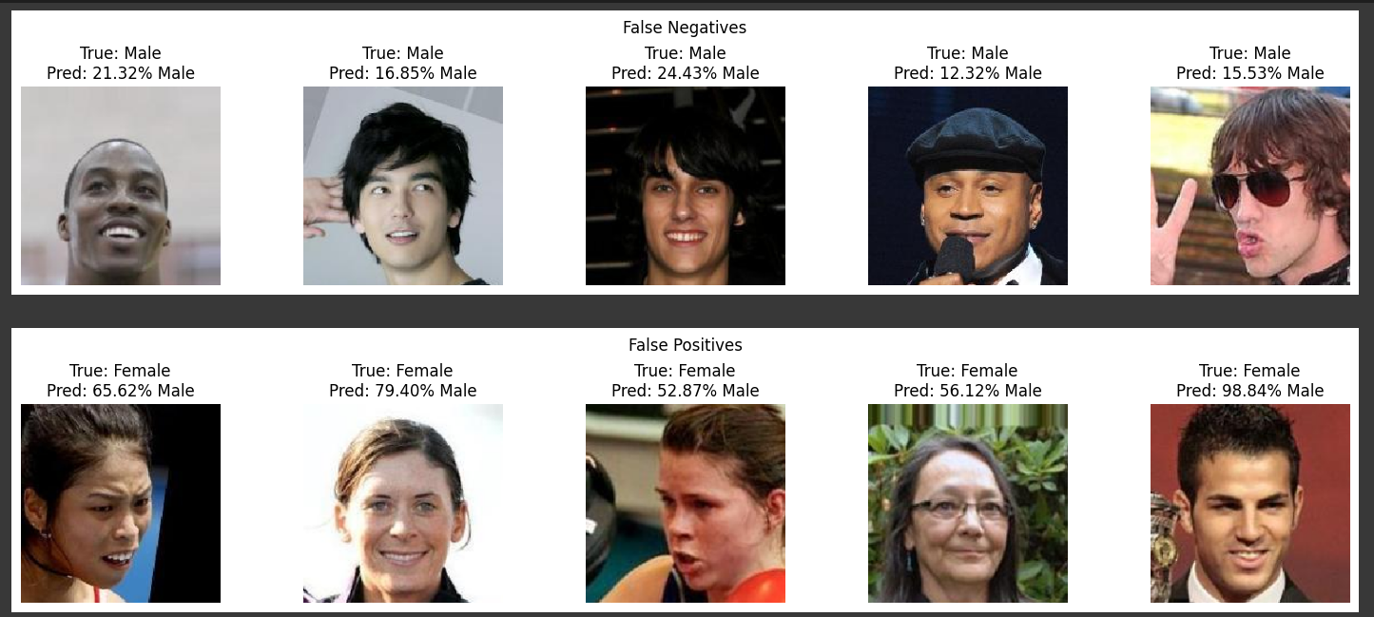
Evaluasi
VGG19

Slide 24
GoogLeNet
Preprocessing
Arsitektur Model
Hyperparameter
Evaluasi
accuracy

Slide 25
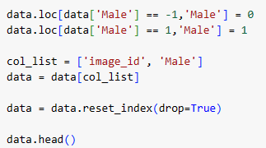
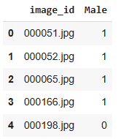
Preprocessing
Change the Feature Value -1 to 0

Slide 26
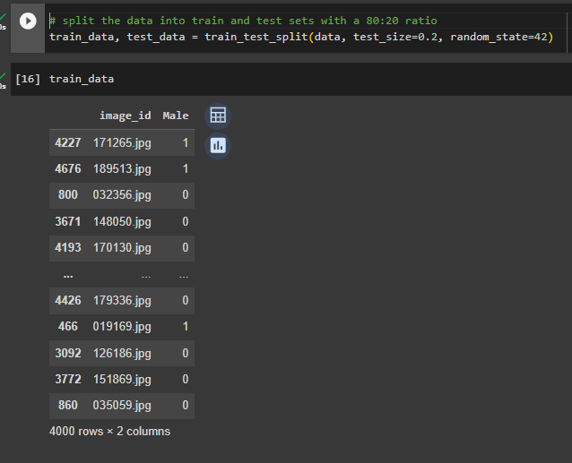
Preprocessing
Split into train and test

Slide 27
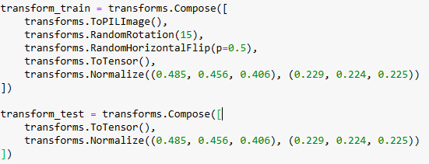
Preprocessing
Transform the train dataset

Slide 28
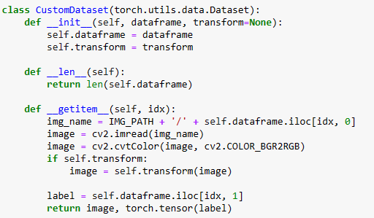
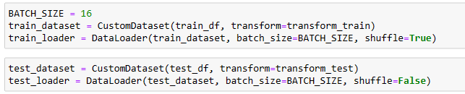
Preprocessing
Create Custom Dataset and Data Loader
Batch Size 16

Slide 29
Arsitektur Model
Input
218 x 178 x 3
Feature Exctractor
GoogleNet with pretrained weights
Fully Connected Layers
Flatten & 3 Dense layer with relu activation
Output
Dense 1 neuron activation sigmoid
Binary cross entropy loss

Slide 30
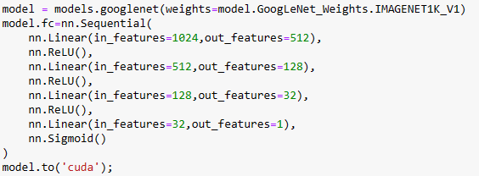
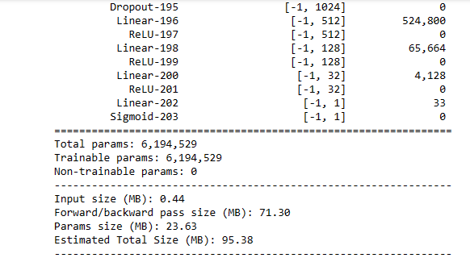
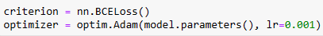
Load Model GoogleNet with pretrained weight

Slide 31
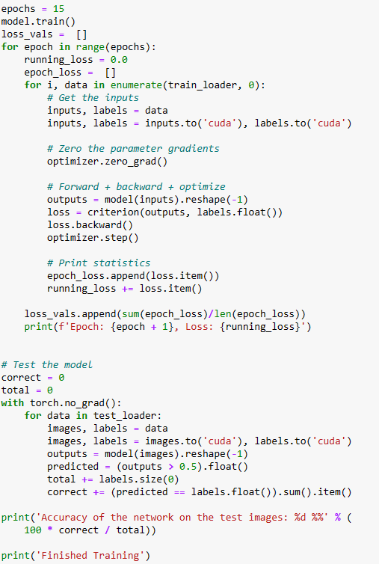
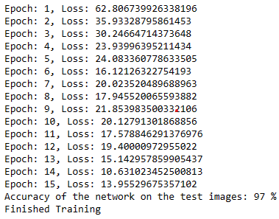
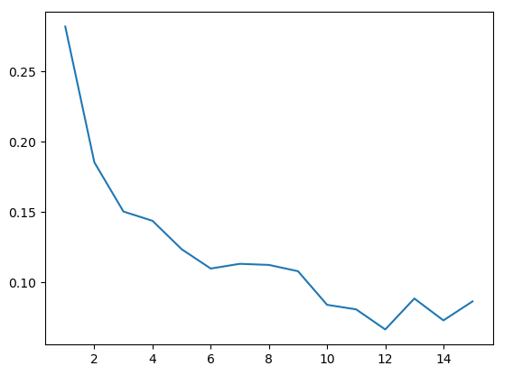
Training and Testing

Slide 32
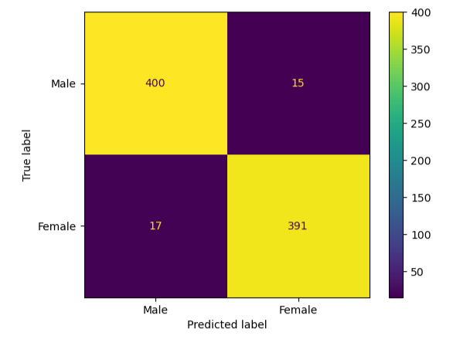
Confusion Matrix

Slide 33
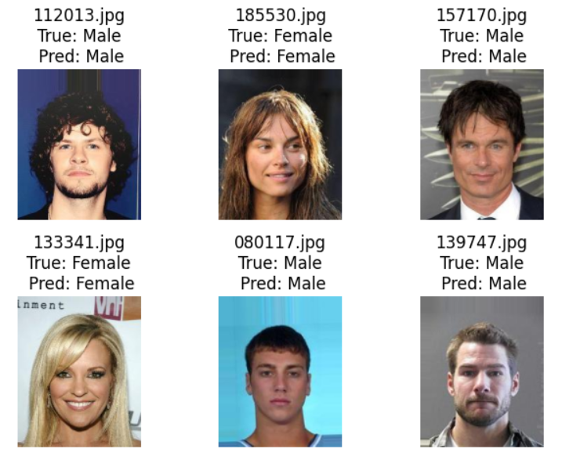
Evaluation

Slide 34
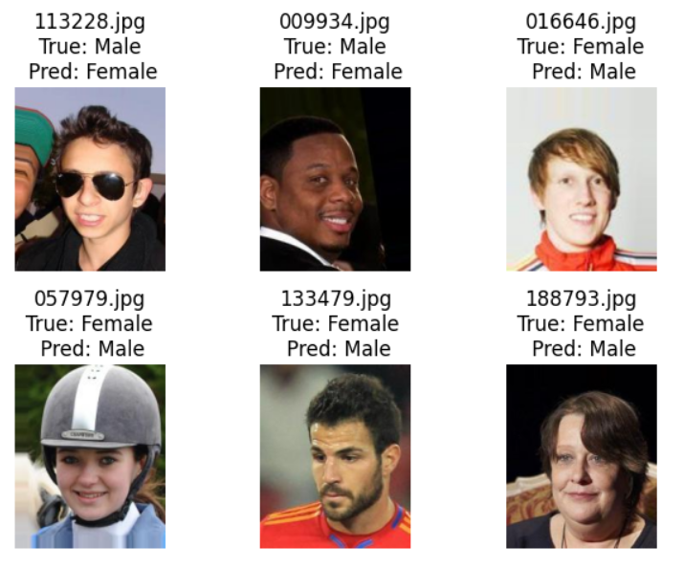
Evaluation
There is some false labelling.

Slide 35
ResNet
Preprocessing
Arsitektur Model
Hyperparameter
Evaluasi
accuracy

Slide 36
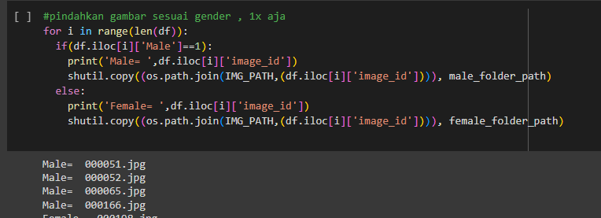
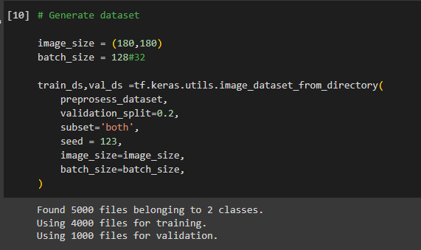
Preprocessing

Slide 37
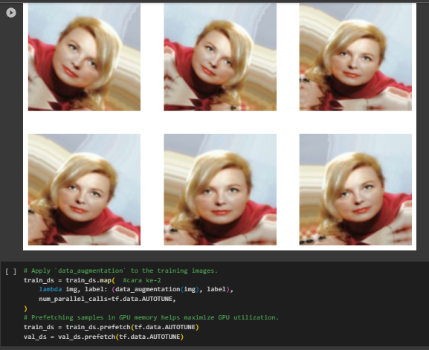
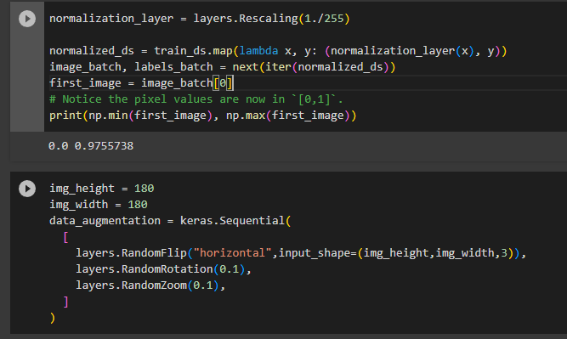
Preprocessing

Slide 38
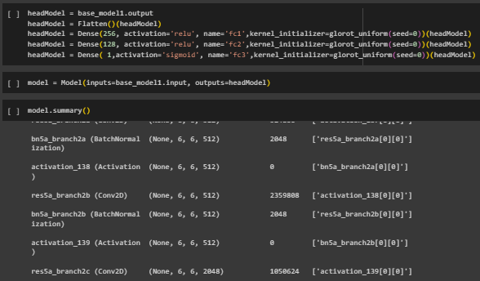
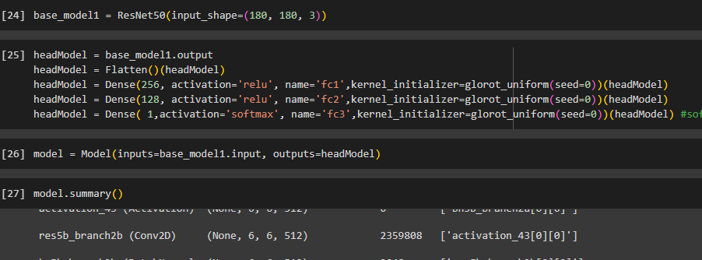
Model - Resnet50 dengan activation Sigmoid
Model - Resnet50 dengan activation Softmax

Slide 39
Arsitektur Model
Input
180x180x3
Feature Exctractor
RESnet50 with pretrained weights
Fully Connected Layers
Flatten & 2 Dense layer with relu activation
Output
Dense 1 neuron activation sigmoid
Binary cross entropy loss

Slide 40
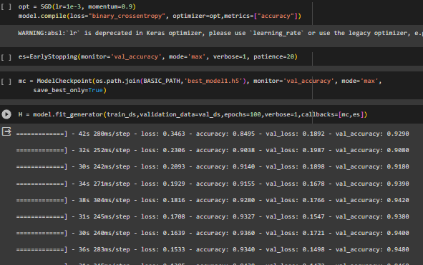
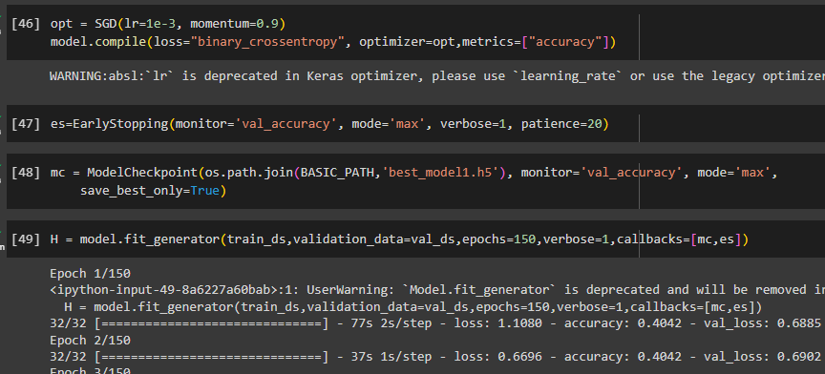


Train Model- Resnet50 dengan activation Sigmoid
TrainModel - Resnet50 dengan activation Softmax
Resnet50 dengan activation Sigmoid menghasilkan akurasi yg lebih tinggi

Slide 41








Prediksi - Resnet50 dengan activation Sigmoid
Pria
prediksi salah
Wanita
prediksi salah

Slide 42
Model Comparison
Model | Test Accuracy | Weights Size
VGG16 | 92.48% | 105 MB
VGG19 | 92.28% | 125 MB
GoogLeNet | 97% | 95 MB
ResNet | 94.80% | 108 MB

Slide 43

Kesimpulan dan Saran
Semua model mampu memberikan hasil akurasi cukup tinggi > 90%
Model terbaik dalam project ini GoogLeNet dengan akurasi test terbesar 97% weights size terkecil 95 MB
Untuk improve hasil, dataset bisa ditambah variasi image wajah dengan lebih banyak data dari sudut pandang yang berbeda

